Slide 1


How Python helped me break into game development
Susan Shu Chang

Slide 2

About me
Quill Studios
Developer
Writer
PM
Marketing
Other work
Co-organize AISC (ML livestreams)
Data Scientist

Slide 3
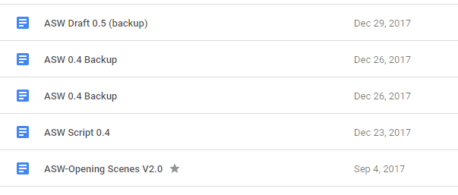
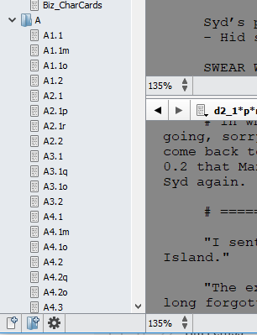
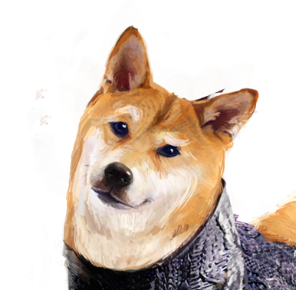
I started this project 2+ years ago...
I have the story,
now what?

Slide 4
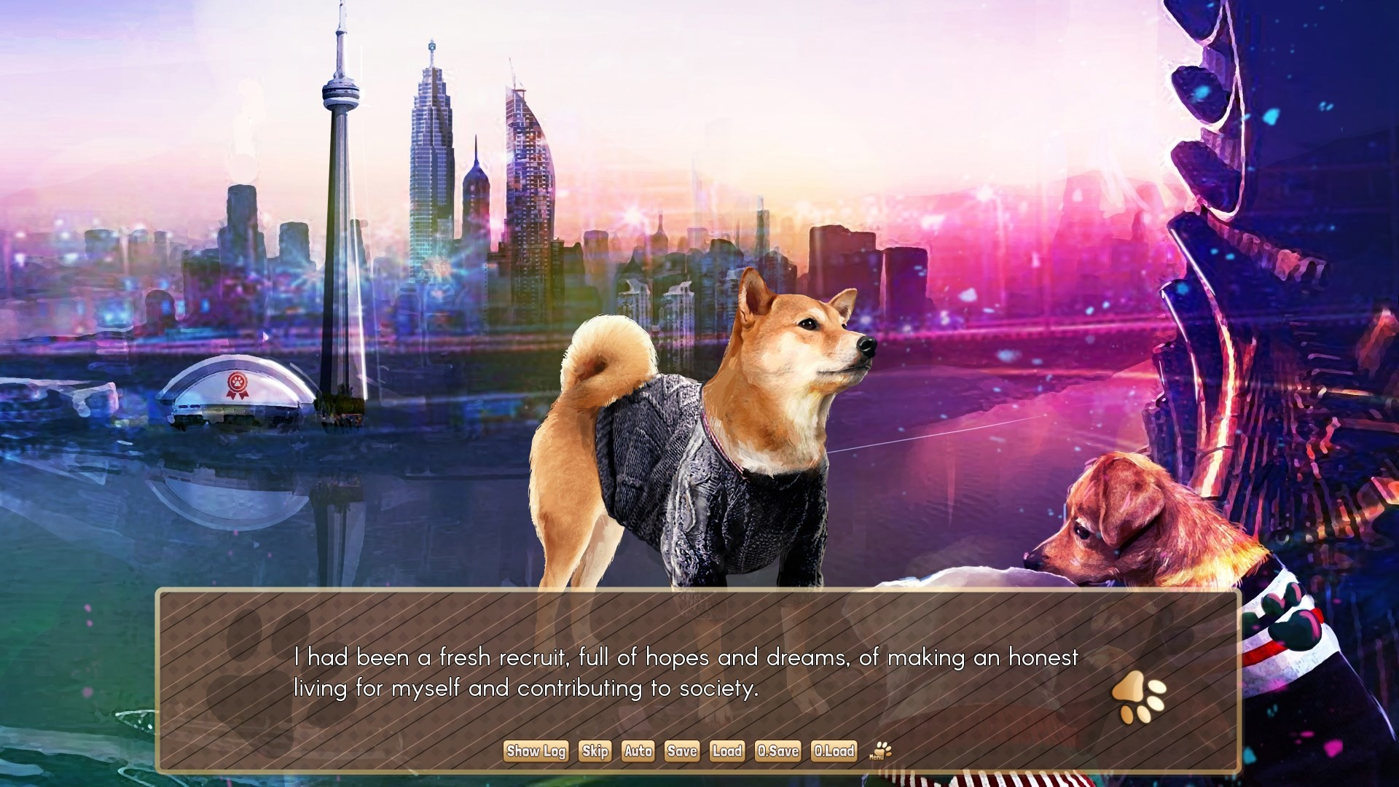
A Summer with the Shiba Inu, made in Ren’Py
Location: Canine-da 🍁

Slide 5
Talk overview
Overview of gaming industry
Narrative games (visual novels)
Ren’Py, open source Python-based game engine

Slide 6




AAA studios typically are large, have funding

Slide 7
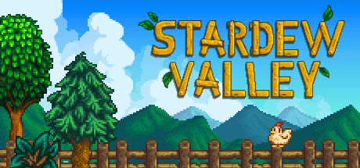
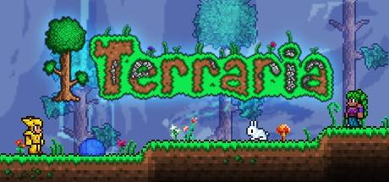

Indie studios are smaller, yet grew popular
(Short for independent)

Slide 8

Some “indies” have large budget; ambiguous

Slide 9

Roles in game development
Narrative design, writing…
Game programmer, Engine/Physics developer
Producer, project coordinator…
3D artist, animator, concept artist...

Slide 10
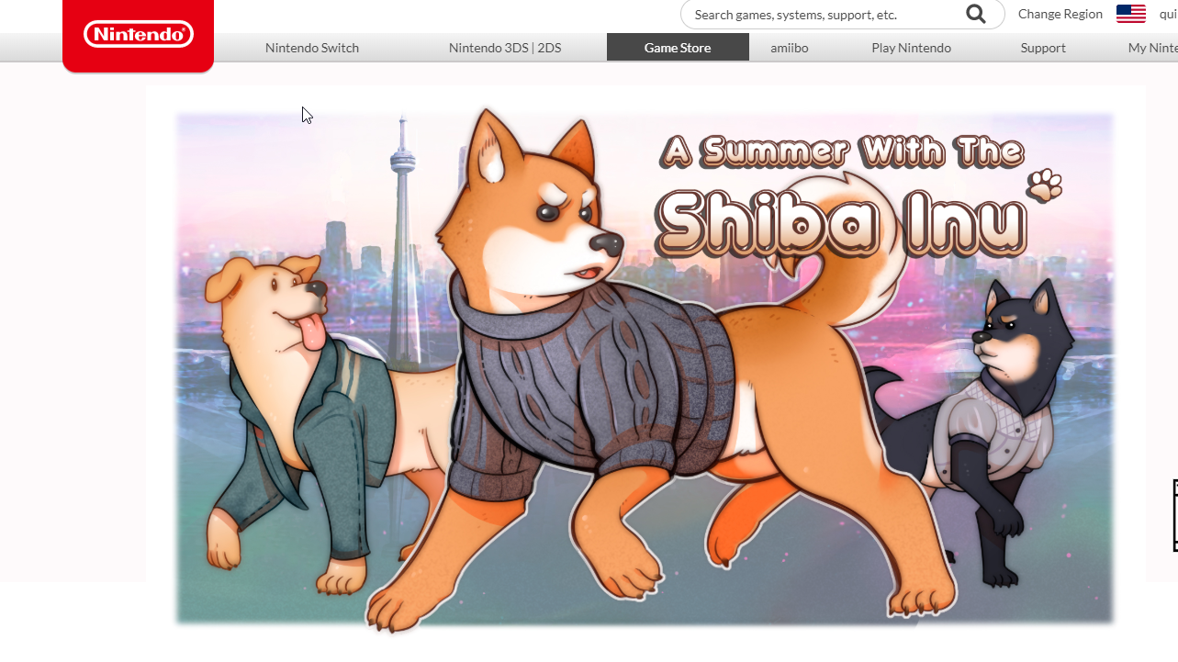
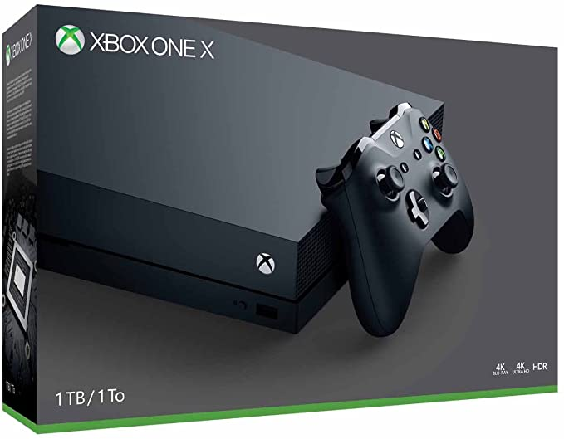


Platforms: computer OS and consoles
Windows, Linux, Mac
Nintendo Switch
XBox One
Playstation 4

Slide 11
Console gaming in India
“The PlayStation 4 was launched at a smashing ₹39,990 in India.”
“The size of the console gaming market in India is estimated [...]
₹700 Crore (7 billion) to ₹750 Crore (7.5 billion) at the basic consumer level
₹450 Crore (4.5 billion) for hardware
₹250-300 Crore (2.5-3 billion) for software.”
Source: https://www.spieltimes.com/original/the-ps4s-preponderance-in-india-a-critical-research/

Slide 12

Python helped me enter “indie” development
Already use in my full-time job
Great documentation
Object oriented programming

Slide 13
Talk overview
Overview of gaming industry
Narrative games (visual novels)
Ren’Py, open source Python-based game engine

Slide 14
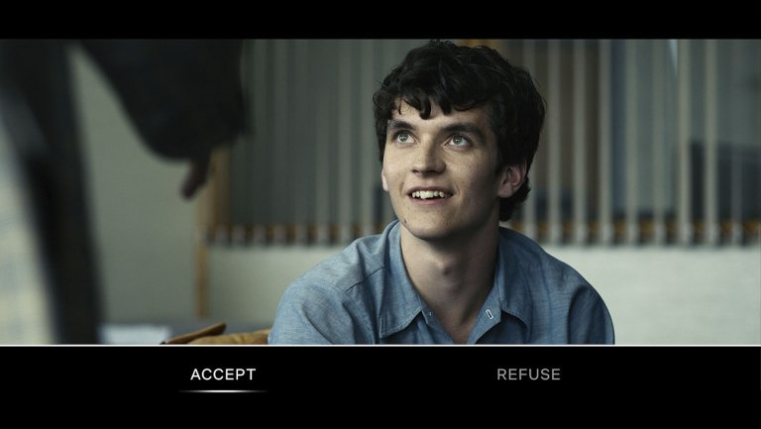

“Narrative-driven” can be done many ways

Slide 15


“Narrative-driven” can be done many ways

Slide 16

“Visual novel” style narrative delivery is popular
Persona 5
Credit: Atlus USA

Slide 17

“Visual novel” style narrative delivery is popular
Danganronpa V3
Credit:
Spike Chunsoft

Slide 18

Difficult to build custom engine as solo dev
Custom engines are everywhere!

Slide 19

Difficult to build custom engine as solo dev
Custom engines are costly

Slide 20
Difficult to build custom engine as solo dev
Custom engines are everywhere!

Slide 21

Difficult to build custom engine as solo dev
Custom engines are costly

Slide 22
Talk overview
Overview of gaming industry
Narrative games (visual novels)
Ren’Py, open source Python-based game engine

Slide 23

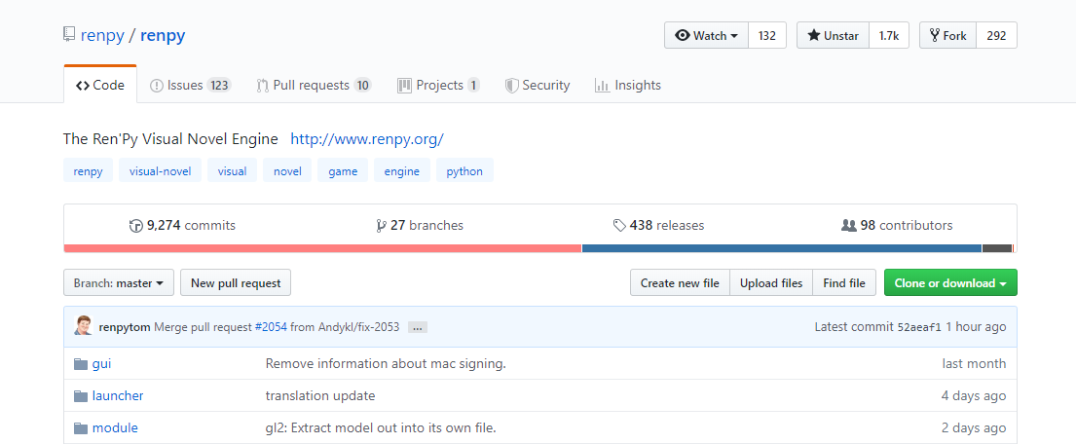
Ren’Py is open source & high production
Games made in Ren’Py
From NaNoRenO to high budget

Slide 24
Ren’Py is open source & high production
Games made in Ren’Py
From NaNoRenO to high budget
PyTom’s philosophy
“The best way to make visual novels, and give it away for free”

Slide 25

Ren’Py is powerful
Doki Doki Literature Club
Credit: Team Salvato

Slide 26

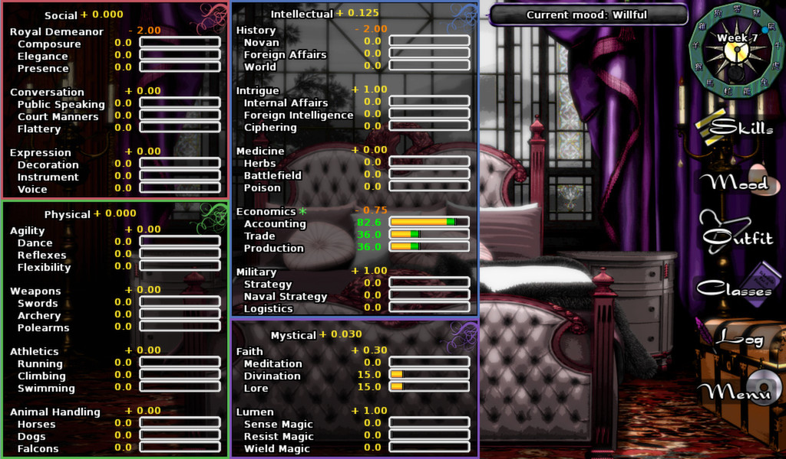
Ren’Py is powerful
Long Live the Queen

Slide 27
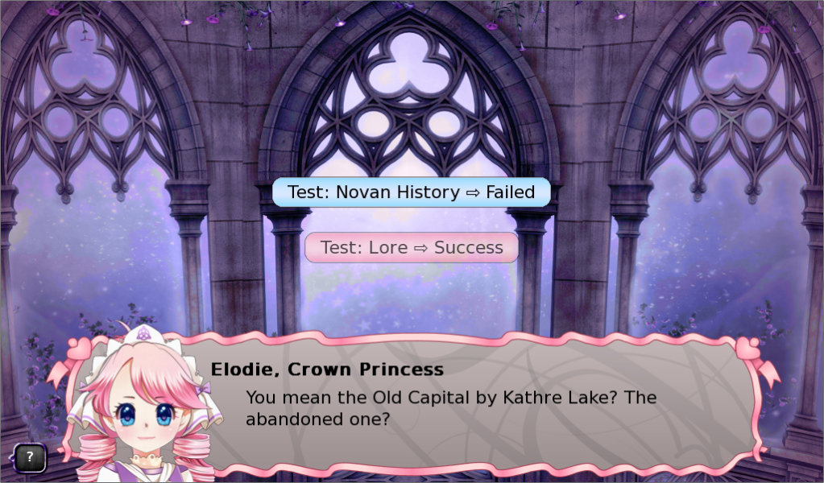
Ren’Py is powerful
Long Live the Queen
Credit: Hanako Games

Slide 28

Ren’Py is powerful
Highway Blossoms
Ren’Py 3D
Credit: Studio Élan

Slide 29

Ren’Py is flexible
Video:
npckc - a hero and a garden

Slide 30
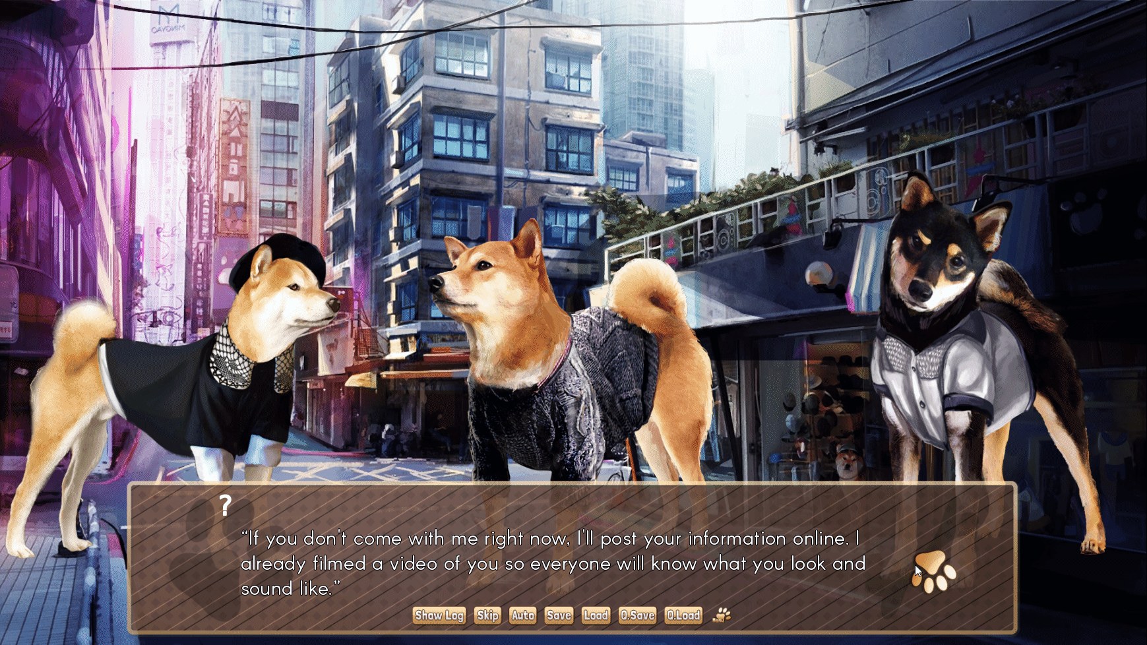
Ren’Py is flexible

Slide 31
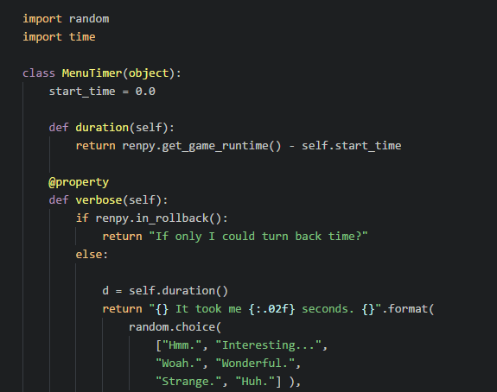
Ren’Py is flexible
Implement timer of how long player took to make decisions
Generates dialogue by randomly selecting and combining phrases

Slide 32
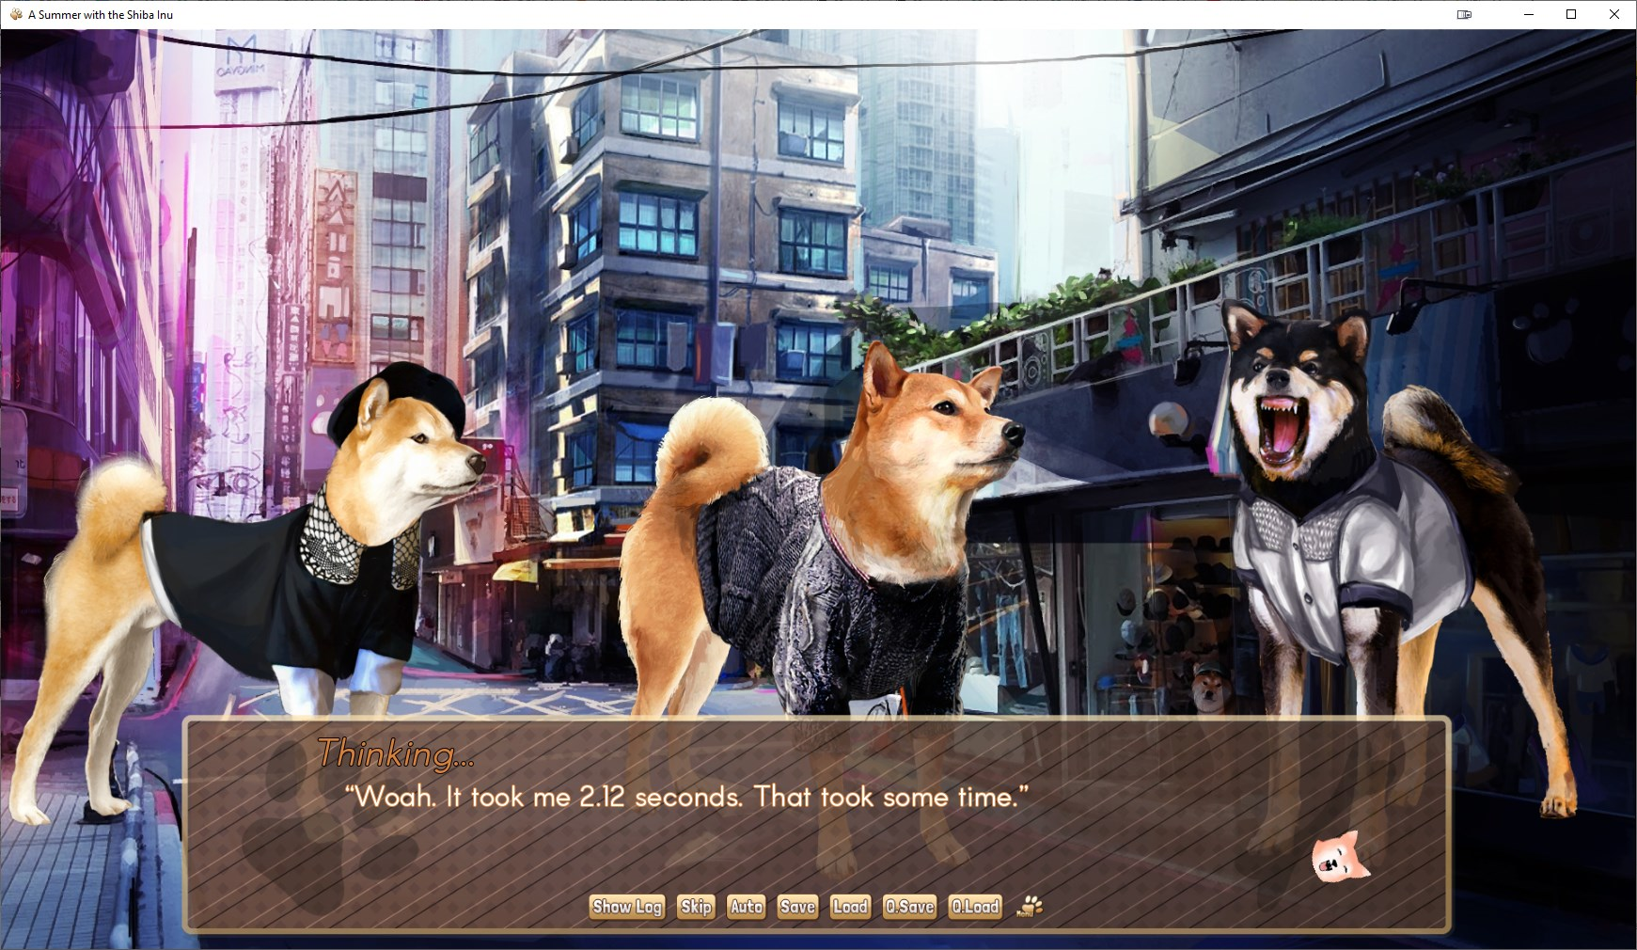
Ren’Py is flexible

Slide 33
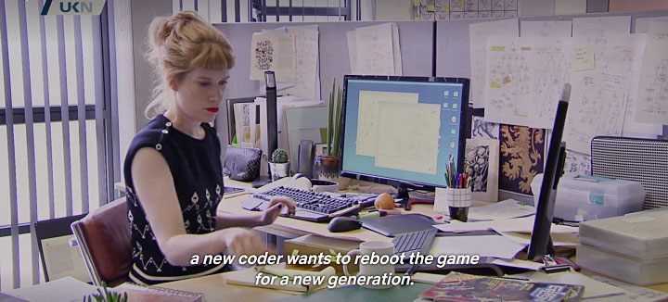
Ren’Py is flexible
You could easily remake Netflix’s Bandersnatch in Ren’Py.
(Its creator used Twine, a popular tool in the VN community, to code the script)

Slide 34

Your imagination’s the limit with Ren’Py
“I can’t make a high production quality visual novel!”
Low budget dev + Ren’Py

Slide 35
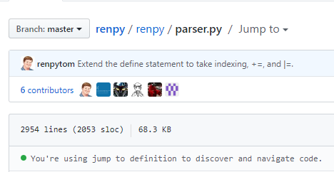
You only have to learn Ren’Py once
New programmer friendly
Flexible for seasoned devs
Thank you RenPyTom, your vision did come true

Slide 36
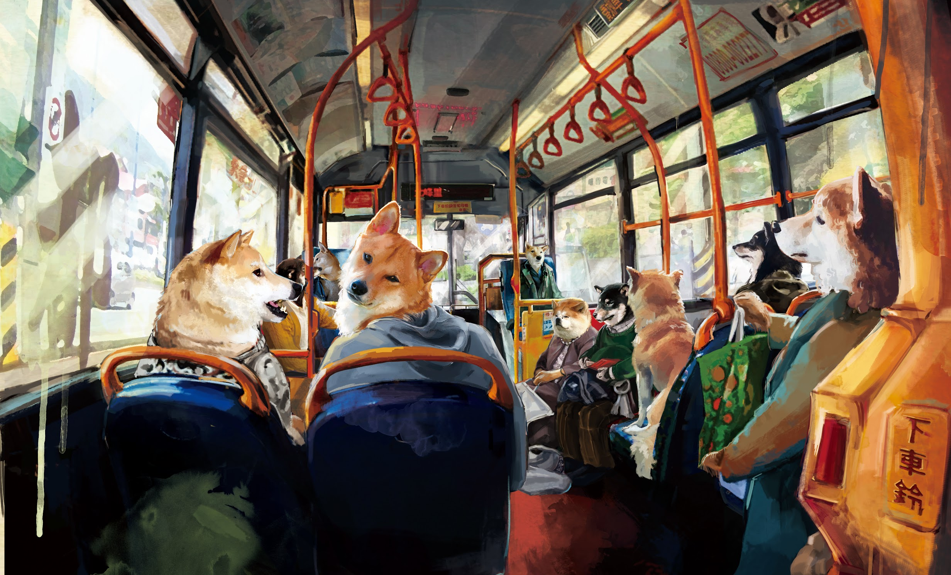


Slide 37

Now go make your story-driven game!

Slide 38





Contact me
@quill_studios
Susan Shu Chang

